Slide 1


Team 30: Smart Pest Repeller
Bi-Weekly Update 2 Michael McNeil
Andrew Albritton
Melquisedec Ordonez Sponsor: Peng Hao Huang TA: Eric Robles
Notes:
Michelle

Slide 2

Project Summary
Pest control methods often involve a compromise by the consumer. Consumers will often have to make the choice between methods that are highly effective with safety concerns such as pesticides, or less effective methods that are much safer like ultrasonic emitters that cover limited frequency.
The smart pest repeller is designed to offer the best of both options by using a machine learning detection program to identify what type of pest is in the target area, and then emitting the correct sound frequency in order to deter the pest from the target area.
Notes:
Kyle

Slide 3
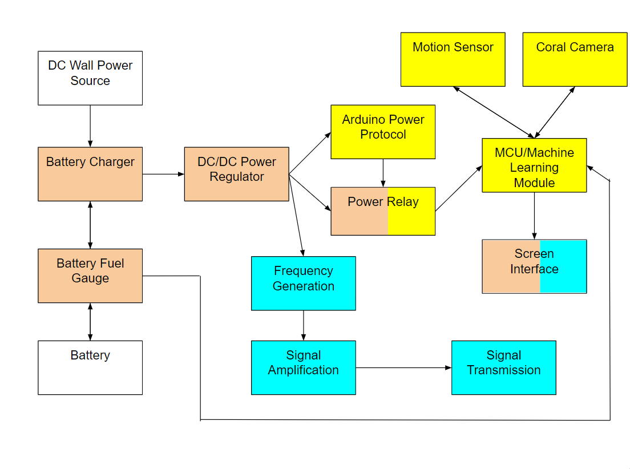
Project/Subsystem Overview
Michael - Orange Andrew - Yellow Mel - Blue
Notes:
Eric

Slide 4
Project Timeline
Subsystem Designs and Testing (to complete 2/23) | Integration of power subsystem and MCU (to complete by 2/29) | Integration of detection and emitter subsystems (to complete by 3/1) | Final Integration (to complete by 3/10) | System Test (to complete by 3/25) | Validation (to complete by 4/8) | Demo and Report (to complete by 4/15)
Notes:
Eric

Slide 5
Power Subsystem
Michael McNeil
Accomplishments since 403 25 hrs of effort | Ongoing progress/problems and plans until the next presentation
-PCB Redesign Layout -PCB Order | PCB Assembly Subsystem Testing and Validation Start Integration with MCU

Slide 6
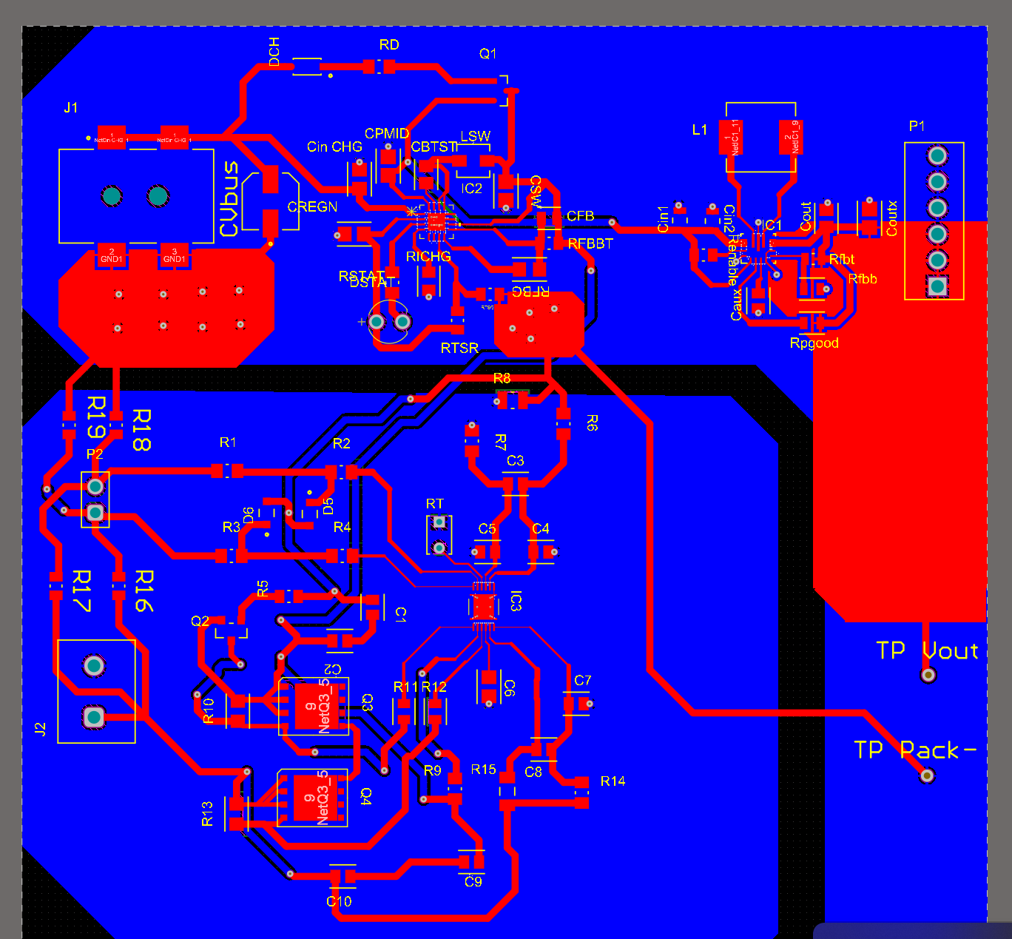
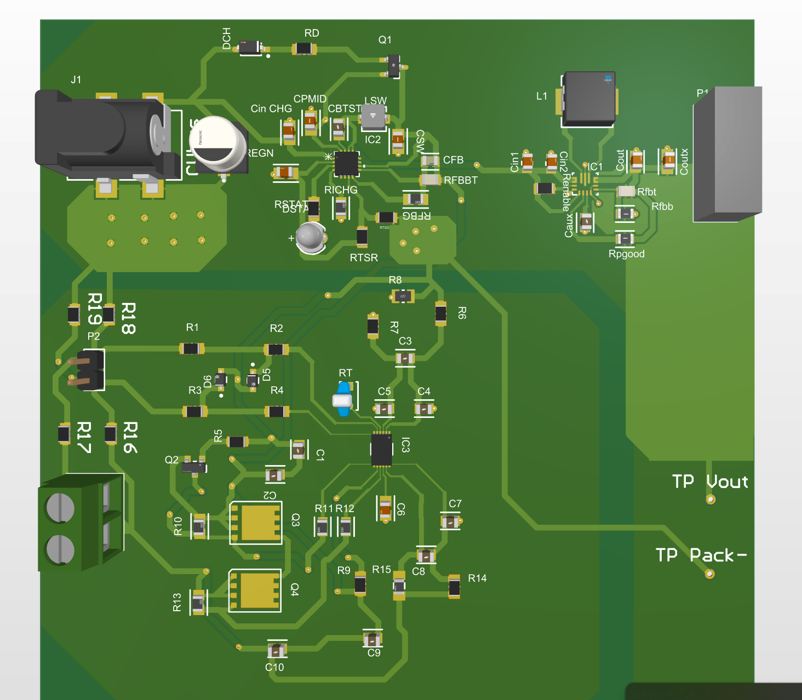
Power Subsystem
Michael McNeil

Slide 7
ML / Control Subsystem
Andrew Albritton
Accomplishments since 403 22 hrs of effort | Ongoing progress/problems and plans until the next presentation
Relay and MCU shutdown control for power system integration completed and undergoing testing Data-Set rebalanced Confusion matrix changed to integer values for more accurate validation | Model’s hyperparameters need to be adjusted in accordance with new optimizer being used. Training runs are performed over-night every day Change boot conditions of MCU, so the model will run on boot.

Slide 8
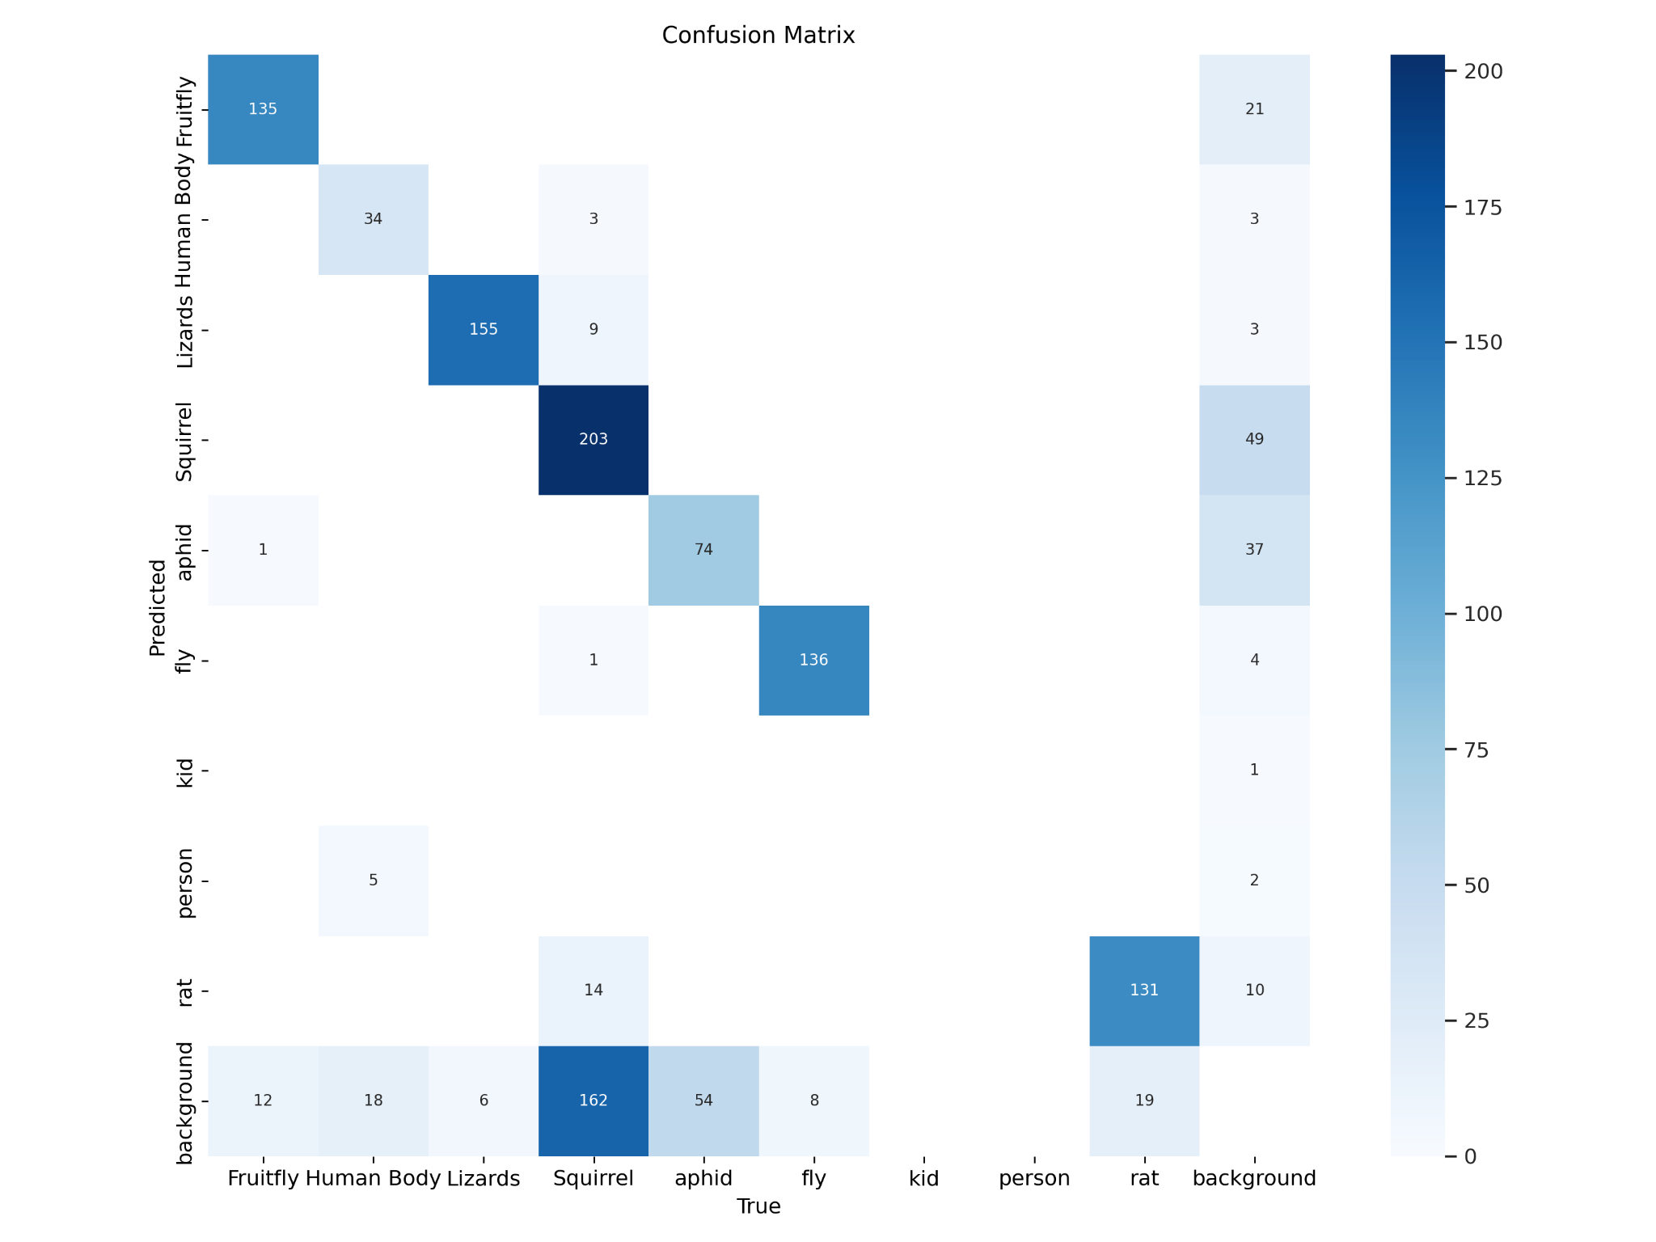
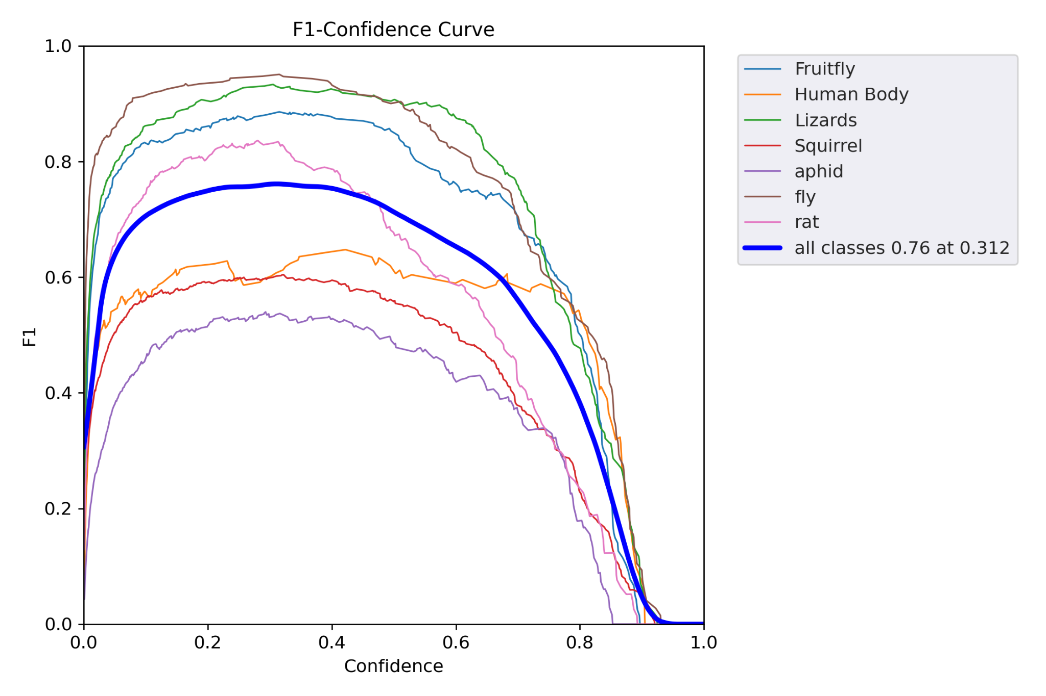
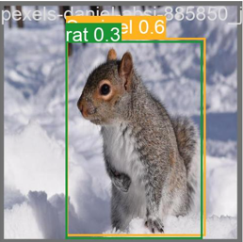
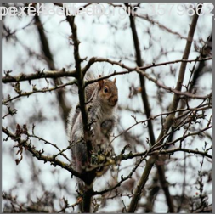
ML / Control Subsystem
Andrew Albritton

Slide 9
Emitter Subsystem
Melquisedec Ordonez
Accomplishments since 403 13 hrs of effort | Ongoing progress/problems and plans until the next presentation
Redesigned Schematic complete | Routing PCB System screen description/information Moving SPI communication to MCU

Slide 10
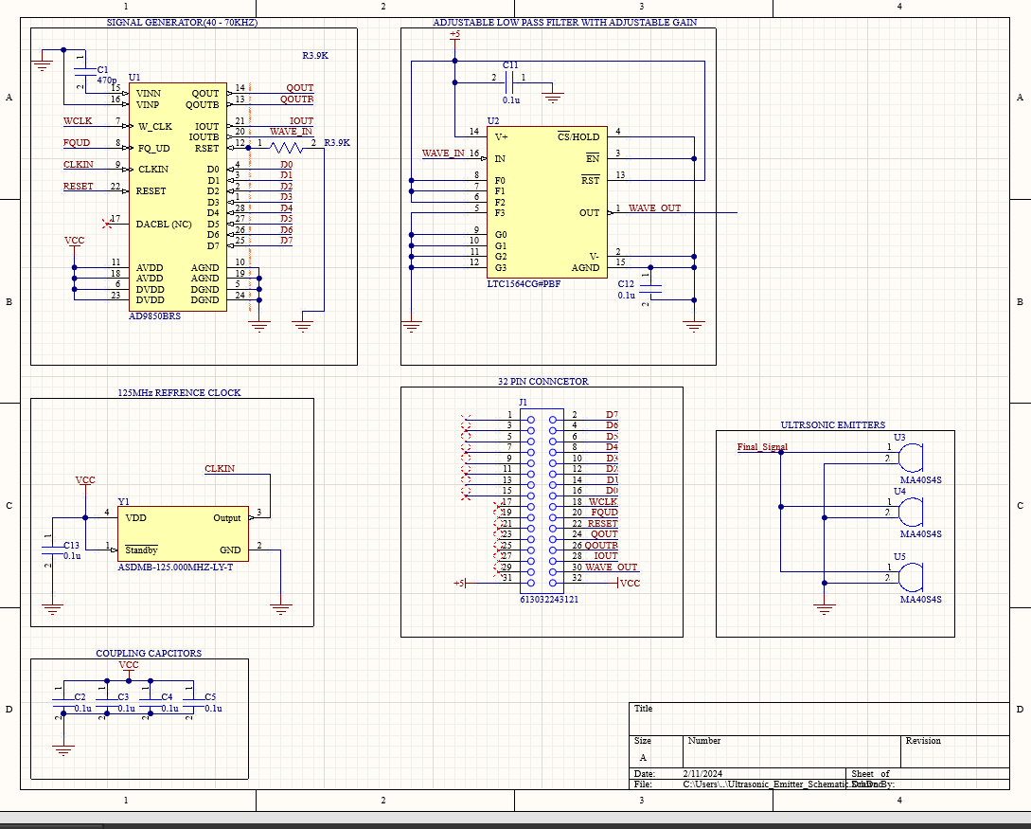
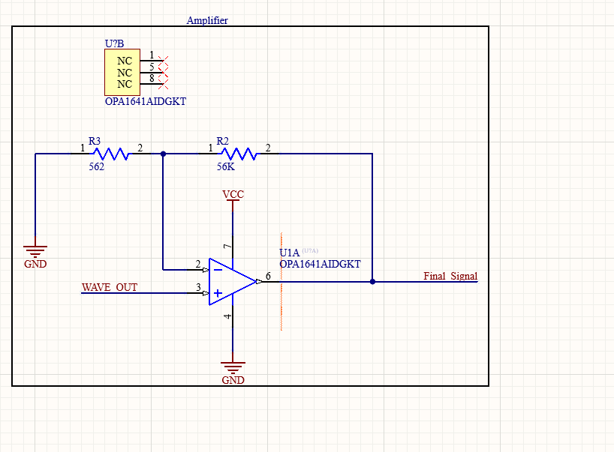
Emitter Subsystem
Melquisedec Ordonez

Slide 11
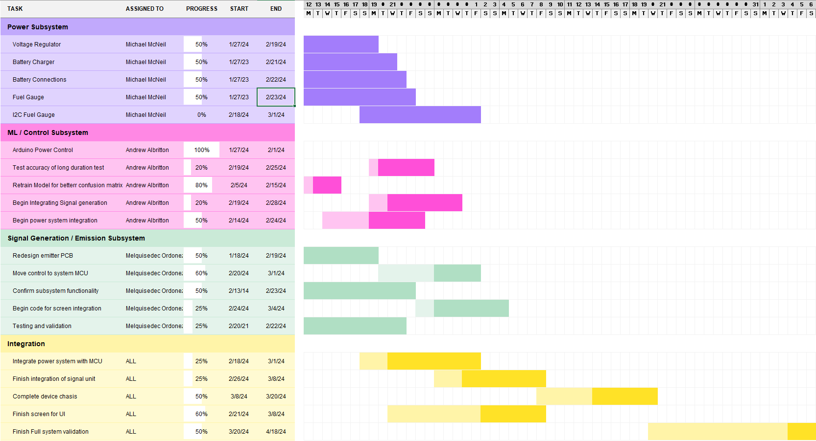
Schedule

Slide 12
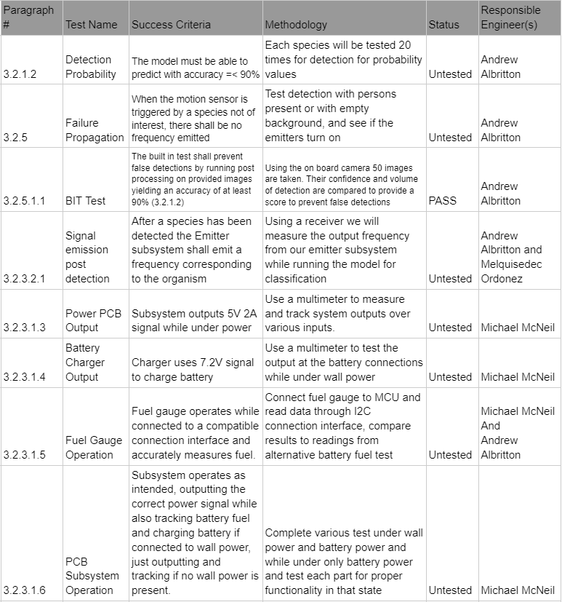
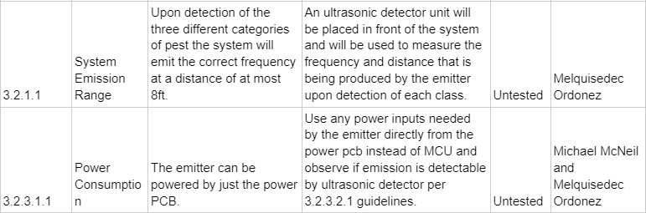
Validation Plan

Slide 13
Thank you.

